Slide 1

Welcome to Nursery – FKS1
Curriculum meeting
September

Slide 2
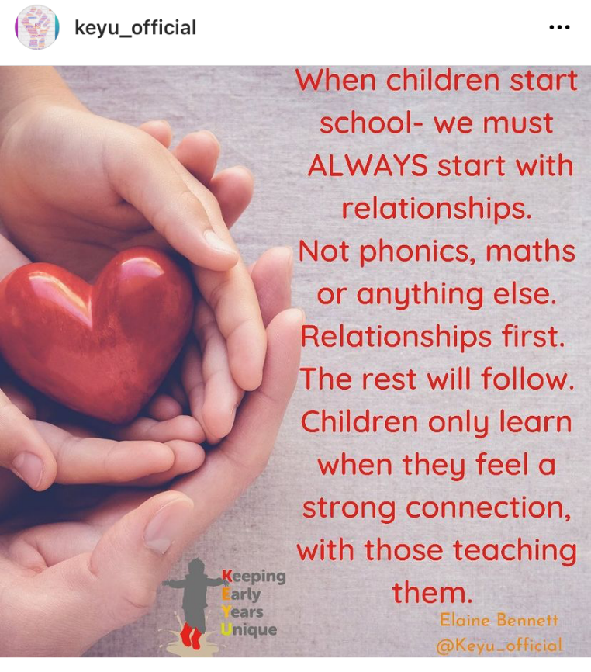

Slide 3

Nursery Staff
Mrs Lee
Mrs Turner
Mrs Owen
Childcare Manager – Amy
Teaching Assistants – Mia and Nafisa
Mrs Rothwell - PPA

Slide 4




Family Groups
ACORNS CLASS – Mrs Lee
Bumble Bees and Ladybirds
CONKERS CLASS – Mrs Turner
Red Butterflies and Blue Butterflies
A member of staff leads each group, swapping half-termly.

Slide 5
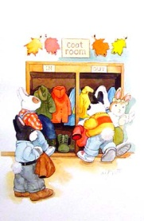

Our Nursery Session
Welcome Time
Wake & Shake
Family Groups
Discovery Time then Pom-Poms!
Phonics – Moving Maths Monday – ERIC/library
Lots of stories!
Lots of singing!

Slide 6



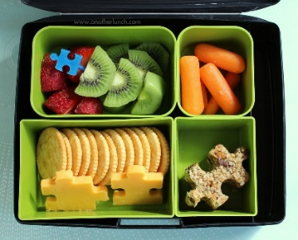
30 hours Nursery session
Gross and Fine Motor activities / Daily Dash
Lunchtime
Discovery Time in Pinecones
Back to Nursery for the afternoon session

Slide 7



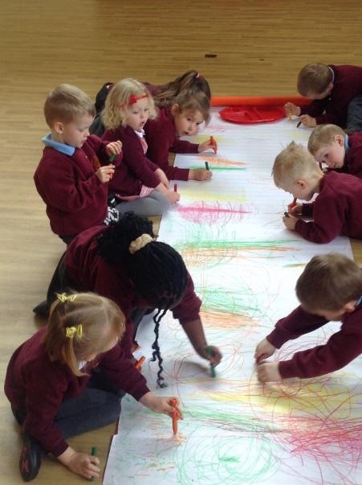

Gross & fine motor skills
www.spreadthehappiness.co.uk

Slide 8



7 Areas of Learning
The Prime Areas:
Personal, social and emotional development
Physical Development
Communication and Language
The Specific Areas:
Literacy
Mathematics
Understanding the world
Expressive Arts and Design

Slide 9

The Outdoor Curriculum
Makes a positive impact on children's sense of well-being and helps all aspects of children's development.
Offers opportunities for doing things in different ways and on different scales than when indoors.
It gives children first-hand contact with weather, seasons and the natural world.
Offers children freedom to explore, use their senses, and be physically active and exuberant.

Slide 10






Our Nursery Themes
Autumn 1
~ Me and My Community
~ Exploring Autumn
Autumn 2
~Once Upon a Time
~ Sparkle and Shine
Spring 1
~ Starry Night
~ Winter Wonderland
Spring 2
~ Dangerous Dinosaurs
~Puddles and Rainbows
Summer 1
~ Sunshine and Sunflowers
~ Shadows and Reflections
Summer 2
~Big Wide World
~ Splash!

Slide 11
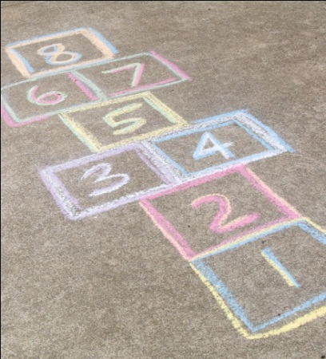

Assessment
The children are assessed using activities in the classroom as well as observations, small group work and sometimes one-to-one activities.
After the baseline assessments this half-term, further assessments are ongoing throughout the year.

Slide 12


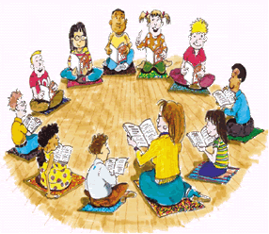

Reading
How we can develop early reading together …
  Focus on developing vocabulary and learning how to join in with back-and-forth conversations.
  Playing picture matching games and jigsaw puzzles.
  Singing nursery rhymes.
  Sharing books – including those in your home language.
  Joining in conversations with adults and children.
Library day is Friday. Children will be able to choose a new book to share at home with you each week, followed by ERIC time. Please return each Friday.

Slide 13

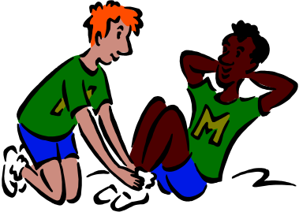
P.E.
P.E day is Thursday.
Real PE curriculum focusing on physical literacy, emotional and thinking skills.
Children must not wear earrings or any other jewellery for health and safety reasons at any time.
Children should come to Nursery wearing appropriate clothing each Monday, e.g. leggings, t-shirts, joggers, pumps or trainers (no laces).

Slide 14

Jigsaw
A mindful approach to supporting the children’s development of personal, social and emotional skills.
Each session begins with a chime and calm time to relax children’s bodies and clear their minds.
Jigsaw Jenie – when you hold her it’s your turn to talk.
6 puzzles throughout the year, the same for each year group, beginning with ‘Being me in my world’.

Slide 15

Proud Cloud
To celebrate the learning your child does at home.
Tell us about anything you are particularly proud of and that can support our assessment of your child during the year. You can include a photo too if you would like.
Ideas may include:
  Fastening their own coat
  Trying something new to eat, e.g. a different vegetable
  Riding a bike without stabilisers

Slide 16
Birthdays
We celebrate birthdays by…
Singing ‘Happy Birthday’
Giving the child a birthday card and/or sticker
If you wish to buy a present for the class e.g. a book or a game, you are more than welcome to do so.
Please do not send any sweets etc. into school as we have many dietary requirements and allergies. Thank you.

Slide 17

Online Safety
Children in Nursery will not use the internet alone. All access to the internet will be done alongside an adult.
Please think about online safety when children play on your phone or tablet.
We will be teaching the children how to stay safe online throughout the year.

Slide 18
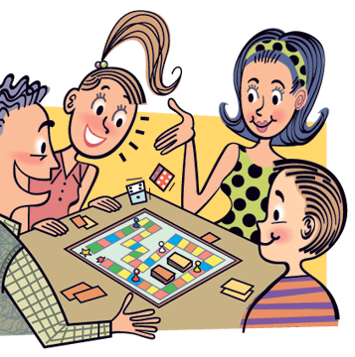



How to help at home
Share books with your child as much as possible – visit the local library.
Let them dress and undress themselves. Practise putting shoes and coats on and taking them off.
Play games that involve turn-taking, e.g. pairs, snap.
Sing nursery rhymes and counting songs.
Strengthen their grip by pegging out washing, using playdough.
Begin to develop pencil control by painting, colouring and gluing.
Count everything! Forwards and backwards.
Read our weekly newsletter for lots of ideas to help your child.

Slide 19

Things to remember
TOILETING
Keep encouraging and supporting your child to use the toilet independently – School nurses Facebook page, health visitor etc.
Book bags every day.
Coats and filled water bottles everyday – water only. Please name them.
Please let us know on the door if your child has any bumps etc at home, it will save us having to phone you during the day to ask about them.
If someone different is picking up your child please inform Nursery staff on the gate or email the school office office@blossomfield.solihull.sch.uk Use a password if you wish.
s4nursery@blossomfield.solihull.sch.uk can be used to ask us any questions.

Slide 20


Slide 21


Social Media
Follow us on Twitter and use the school website to find out more about what we are all doing at school.
www.blossomfield.solihull.sch.uk
@Blossomfieldsch
@blossomfieldchildcare

Slide 22


